Slide 1


Call Center Performance Dashboard Insights
Purpose of the project: Analyzing Key Metrics and Trends for Call Center Presented by: Krupa Patel

Slide 2
Project description
The given project is to analyse Call-Center data and draw some insights from it.
PowerBI is used to perform the visualization, allowing us to develop new measures using DAX Expressions and has varied charts.
In this project we are required to clean the data, find the total calls, Average call duration, Response Time, Call Duration in hours and minutes, Total number of calls by day, sentiment, channel, call-center , state and call reason.

Slide 3
KPI’S EXPLANATION
Total No Of Calls : We need to track and display the total number of calls received by our call center over a specified period.
Total Call Duration in Hours : Understand the total amount of time our call center staff spends on calls in hours, which can help us in resources allocation and capacity planning.
Total Call Duration in Minutes : Similar to the total call duration in hours, this KPI provides the total call time but in minutes, offering a more granular view of call durations.
Average Call Duration in Minutes: Analyze the efficiency, we need to calculate and display the average call duration in minutes. this metric can help identify trends in call handling.
Response Time (%): Find the percentage of calls that were responded within the target time

Slide 4
Data Loading and Transforming
The dataset was in an Excel file format and loaded in PowerBI.
The data was cleaned by removing error and duplicates.
The date column was transformed and divided into other columns day and month name.
Day and week name was derived from date column by changing it’s format type.

Slide 5
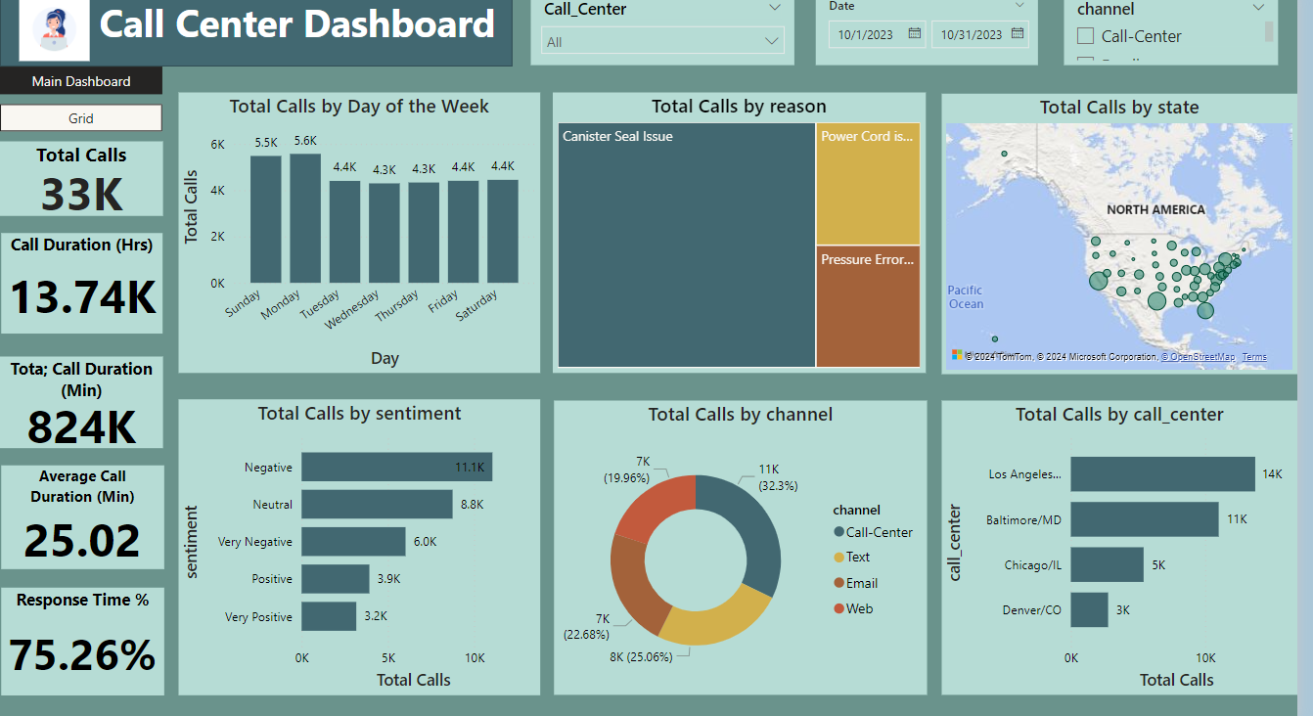
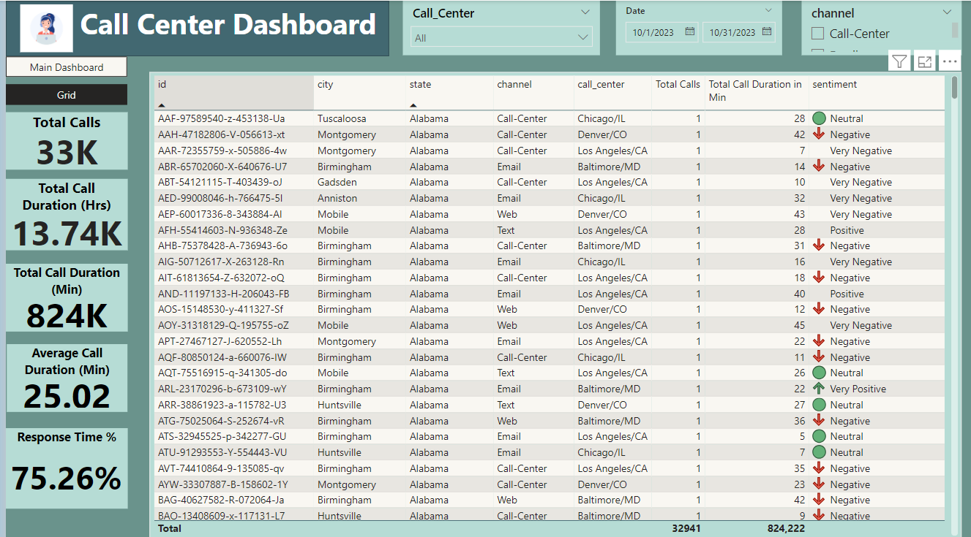
Dashboard

Slide 6
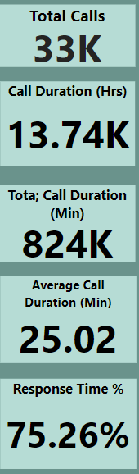
Overview of Key Metrics
Total Calls: 33K
Total Call Duration (Hours): 13.74K hours
Total Call Duration (Min): 824 K minutes
Average Call Duration: 25.02 minutes
Response Time % : 75.26%
Key Insight: The call center handled a significant volume of calls, with an average duration of about 25 minutes per call.

Slide 7
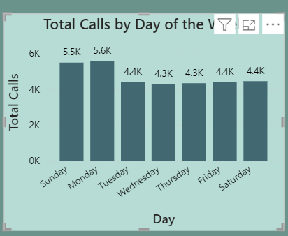
Total Calls by day of the week
Highest volume on Sunday& Monday (5.6K calls)
Consistent call volume from Tuesday to Saturday (around 4.4K calls daily)
Key Insight: Sunday & Monday experiences the highest call volume, indicating a potential need for increased staffing or resources at the beginning of the week.

Slide 8
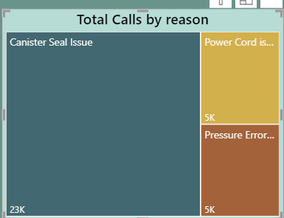
Call Duration Trends
Top call Reasons are:
Canister issues (largest)
Power Cord Issues (second largest)
Pressure Errors (third largest)

Slide 9
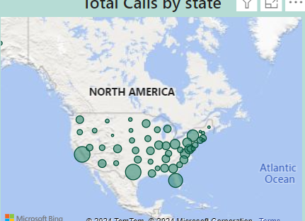
Geographic Distribution of Calls
High concentration of calls from states such as California, Texas, Florida and New York.
Key Insight: The majority of calls come from densely populated areas in North America, indicating where customer demand is highest.

Slide 10
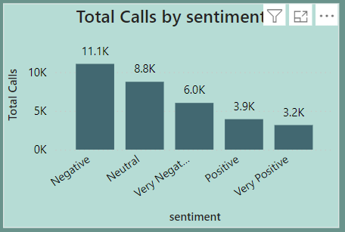
Sentiment analysis
Negative sentiment dominates (11.1K calls), followed by neutral (8.8K) and very negative (6.0K).
Key Insight: A significant portion of calls are associated with negative or very negative sentiments. This could indicate customer dissatisfaction or complex issues that need addressing.

Slide 11
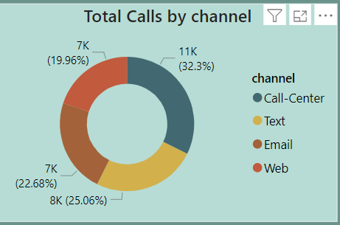
Total Calls By Channel
Call center is the most used channel (32.3%), followed by text(25.06%), then Email (22.68%) and Web(19.96%)
Key Insight: While the call center remains the primary channel for customer interaction, other channels like text and web are also widely used, suggesting a multi-channel approach to customer service.

Slide 12
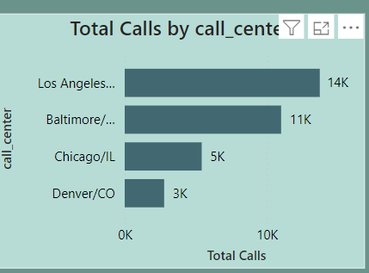
Call center performance by Location
Los Angeles leads with the highest number of calls (14K), followed by Baltimore (11K) and Chicago (5K).
Key Insight: The Los Angeles call center handles the largest volume of calls, which may indicate greater demand or capacity in that region.

Slide 13
GRID dashboard
Use the grid to spot patterns, such as cities or states with frequent negative sentiment or unusually long call durations.
By filtering the grid based on location data, managers can pinpoint regions with high call volumes, enabling more targeted resource allocation.
Comparing call center performance to other channels like Email or Web can reveal insights into customer preferences and the effectiveness of each channel.
By focusing on sentiment, managers can identify calls with consistently negative feedback and investigate potential issues or agent training needs.

Slide 14

Conclusion and Recommendations
Summary:
High call volumes on Mondays suggest a need for additional resources at the start of the week.
Negative sentiment is prevalent, indicating possible areas for improvement in customer service.
Multi-channel engagement is strong but requires balanced support across all platforms.
Recommendations:
Increase staffing on Mondays to handle peak call volumes.
Investigate common issues leading to negative sentiments and implement training or process improvements.
Ensure that support across all channels (call center, text, web) is consistent to maintain customer satisfaction.

Slide 15
Thank you!

